Slide 1
Google Coral Micro Final Presentation
Eye of AI: Owen, Josiah, Nathan

Slide 2
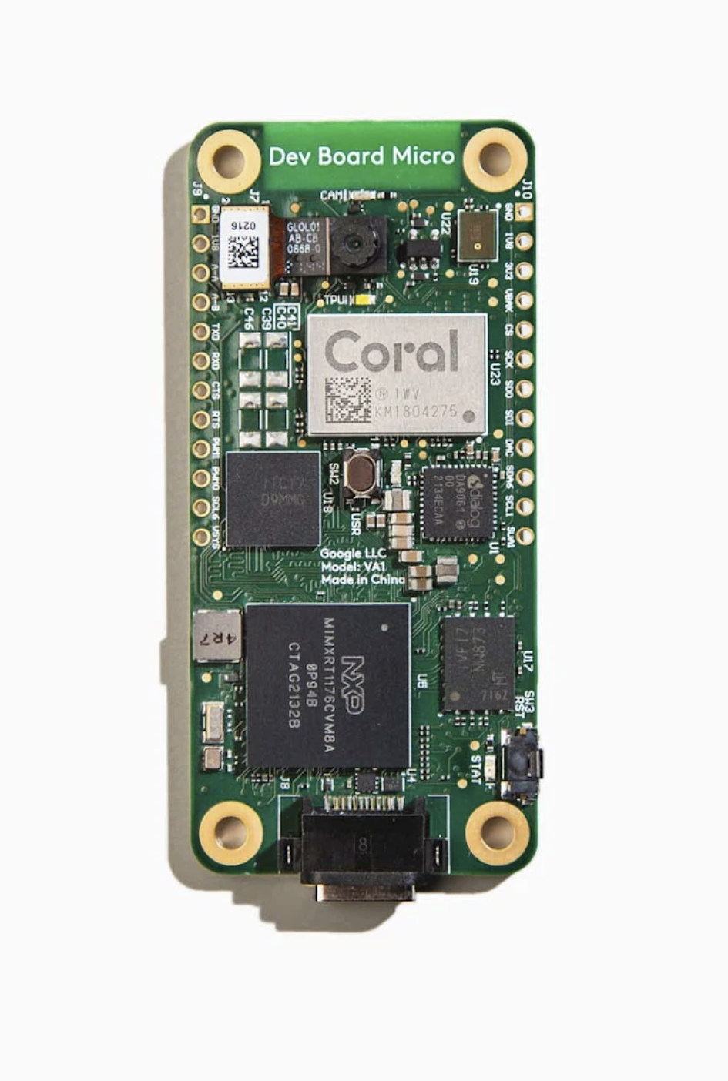
Why?
Motivation and Goals:
Investigate capabilities of Google Coral Dev Board Micro
Interest in comparing performance between hardware and cloud processors
Determine whether access to physical AI hardware provides a large advantage over cloud based AI
Notes:
Josiah

Slide 3


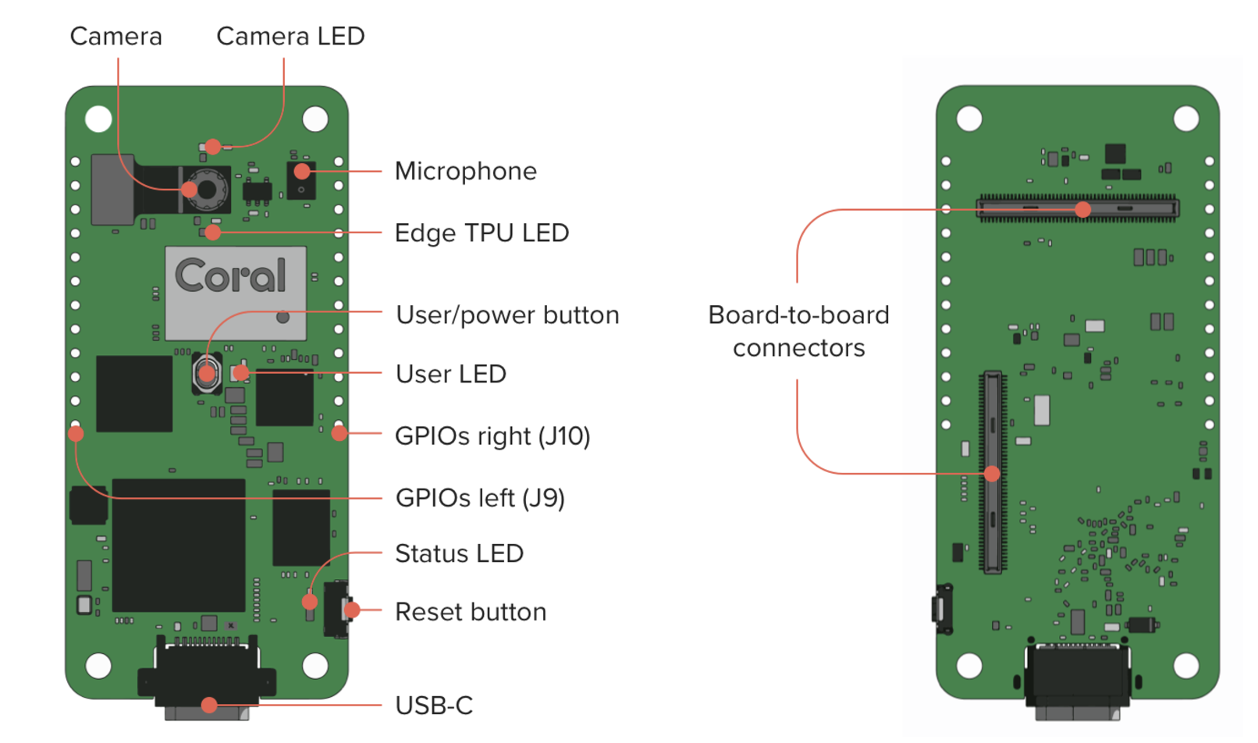
What
Project Objectives
Perform image classification
Compare Coral vs Colab execution time
Determine advantages and disadvantages of physical hardware access
Required Tools
Virtual Machine
Linux Ubuntu 22.04
Google Coral Dev Board Micro
Google Colab
Notes:
Nathan

Slide 4
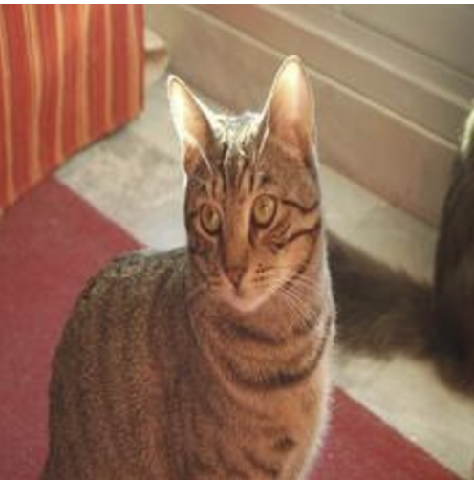

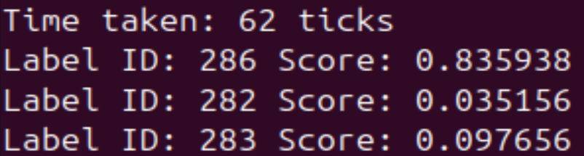
How
Setup board to run example programs
Installed FreeRTOS tools
Ran face detection program
Flashed the board
Depicted in the demo video
Ran image classification program
Classifies cat.rgb image on ImageNet labels
Prints results to serial console
Modified C++ code for timing and model changes
Perform image classification on Google Colab
Inspired by Classification HW
Compare timing results
Notes:
Nathan

Slide 5
Results (Execution Time per Image)
 | MobileNetV1 | MobileNetV2 | InceptionV4
Coral Micro TPU | 62 ms | 61 ms | 155 ms
Colab Cloud TPU | N/A | 35 ms | 36 ms
Notes | MobileNetV1 was not working on Colab |  | InceptionV4 was not compatible with Coral so InceptionV2 was used instead
Notes:
Josiah

Slide 6
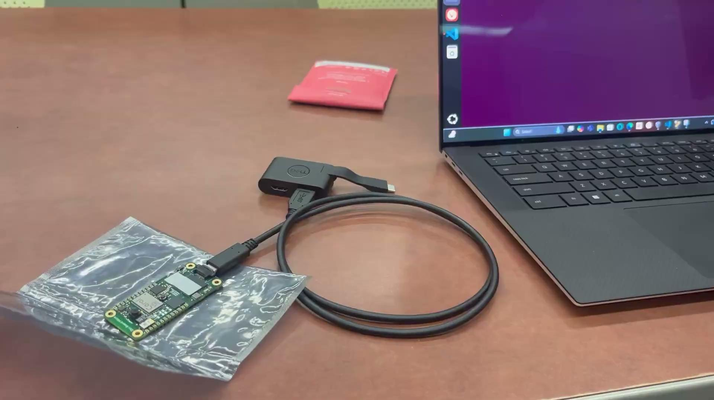
Demo video

Slide 7
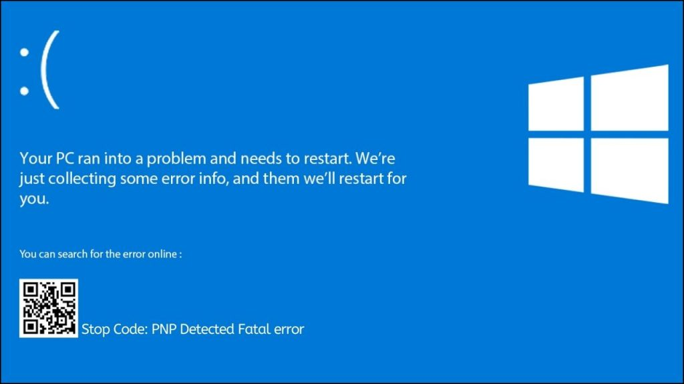
Engineering Insights
Challenges
Virtual machine
USB-C cable
Bugs running code
Computer not detecting board
Blue screen of death
Unpredictable hardware faults
Takeaways
Hardware is less predictable than software
Debugging can take as much time as doing the programming
Google Coral has a lot of capabilities

Slide 8
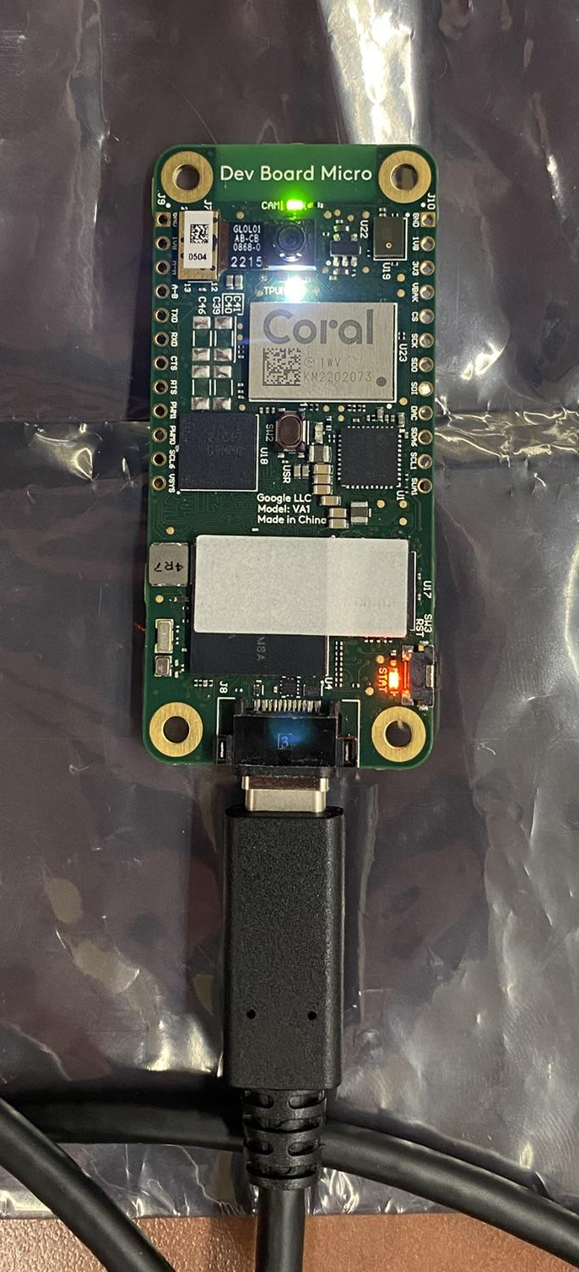
Conclusion
Successfully ran facial recognition program with Coral
Successfully performed image classification with Coral
The hardware learning curve is greater than cloud AI
Found that Colab was faster than Coral when performing image classification
Simplicity of cloud AI benefits beginners
The depth of features on Coral provides more customization

